Slide 1
Reaprich – Phase 1
Progress review
16th Sep ‘23

Slide 2
Scope of phase 1
Projects
Back-end
Front-end
User Management
Outlet Registration
TD Registration
Customer Registration

Slide 3
Database Design

Slide 4
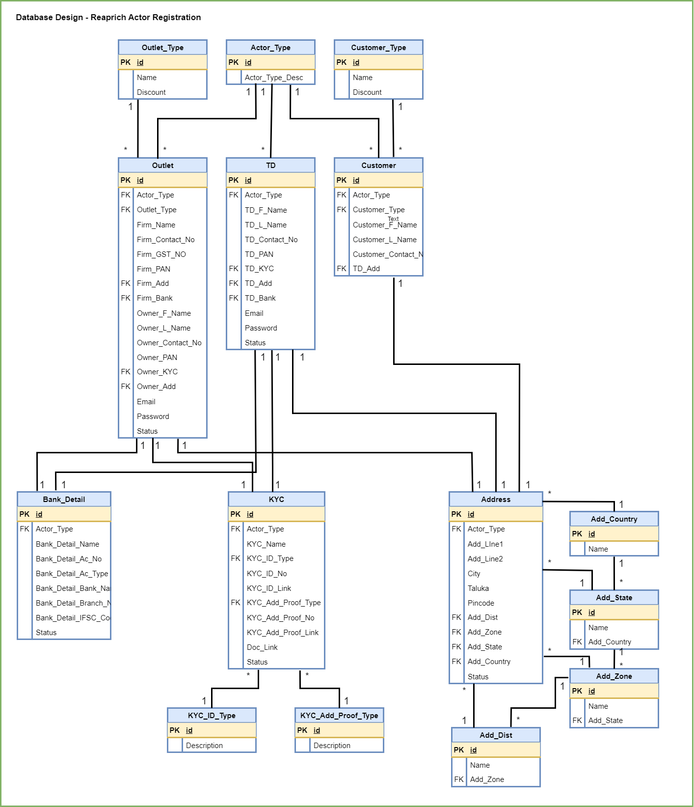

Slide 5
Current State

Slide 6
Status of Development work
Admin Activities
Back-end - Done
APIs for adding Provider Information
APIs for Outlet and TD registration
Front-end – In Progress
UI for admin activities
Database designing - Done
User Management

Slide 7
Next Items
Phase – 1 - Continue development of front-end
Phase – 2 - Security
User Authentication and Authorization
User input Validation

Slide 8
MOM
Outlet and TD registration and management will be done by Admin only. – There is no self registration.
The current understanding and development of back-end is correct and agreed by client.
New Feature requested for 2nd Phase
Sub Admin
Password change OTP

Slide 9
Thank you

